Slide 1
Blockchain Based Customer Reward Management System
Gopika V Baburaj
MCA S3-A
Roll No:54

Slide 2
Objective of study
To build a platform that provide transparency in Customer Reward Management using blockchain.

Slide 3
What does Customer Reward Management system means?
A customer reward management system or customer loyalty program is a program run by a company that offers benefits to frequent customers. Those benefits may be in the form of discounts, rebates, free products, or other promotions.
Goals:-
increase business,
improve sales,
strengthen the relationship between the customer and the business
keep the customer coming back on a regular basis

Slide 4
Problems with Existing system
Now a days customer reward Management or customer loyality programes are widely introduced in various platforms as well as applications.
Since they posses expiry date, many rewards may remain unused.
Less security to the customer information
Also if some organizations mutually posses a customer reward management system there will be chances for cheating as the transactions will not be visible to all the companies.
So some partners may face trust issues or loss.

Slide 5
Proposed System
Since current loyalty program systems put restraints on the relations between partners and prevent visibility for members and also set an expiry date, we propose a system or platform by creating the customer loyalty program on a blockchain network.

Slide 6
Why Blockchain?
Security
Transparency
No expiry date
No trust issues

Slide 7
Use Cases
1. Customer
Register
Sign in and purchase
Earn rewards
Redeem rewards
View transactions
2. Company
Register
Sign in and view transactions
Verify transactions and rewards

Slide 8
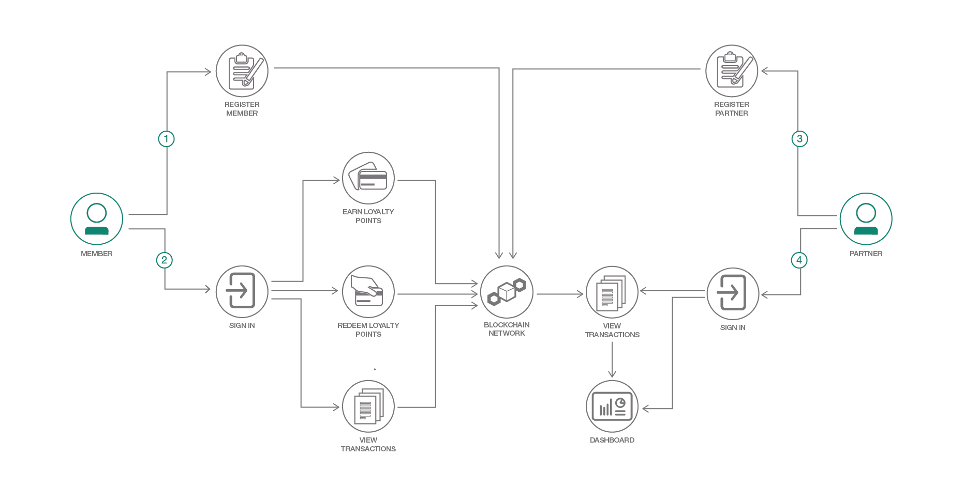

Slide 9
Description of the topic
Customer reward management system using blockchain uses the technologies of blockchain to make the platform transparent and free from malpractices.
Here we have certain companies which are registered in the platform and they offer services to the customer. All the companies or organizations which are registered in the platform will be able to view and verify every transactions that occur in the platform. No malpractices can be done by any companies as all the records are stored in blockchain.
Then the customers who register in the platform will be able to utilize all of the services provided by the organizations registered under this. The companies will set certain reward criteria for most of their services and the consumers who satisfy these criteria will be allocated with certain rewards and all the reward details will be stored in the blockchain.

Slide 10
Relevance of the Topic:
Open systems
More flexibility
Reduced cost
Overall transparency
Less fraud, More security
No expiry date

Slide 11
How to achieve this?
Blockchain technology is a technology that uses decentralized ledgers to keep transaction records. The record of transactions is kept in a peer-to-peer network. There is no central authority needs to confirm the transactions. The transactions are verified by the participants in peer to peer networks.
This architecture uses public and private key cryptography, so the privacy of the data is maintained.
Since all the data is stored in global ledger with encryption and hashing, Blockchain is a tamper-proof mechanism. So no attacker can manipulate the data. It maintains integrity.

Slide 12
Front end, Back end and Algorithm
Front end – HTML with CSS, ASP.NET
Back end – SQL Server to store block chain data
- allows fast data access
Algorithm – SSH(Secure Shell)
- used for encryption
- encrypt the valid data and store in block chain
- Only admin can decrypt using his secret key and view

Slide 13
Thank You!!!

